Slide 1
Mobile Device Connection Methods

Slide 2
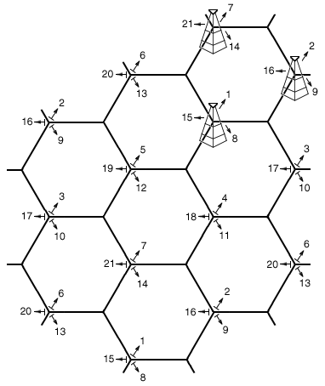
Cellular networks
Mobile devices
“cellular” phones
Service area divided into “cells”
Towers cover each cell
3 towers serve each call
can triangulate phone’s location
Security concerns
Traffic monitoring
Locating tracking
Worldwide access to a mobile device

Slide 3

WiFi
Local network access
Local network security problems
Same security concerns as any other WiFi devices
Device can capture network data
Lost phone can carry sensitive data
Encrypt your data!
Man-in-the-middle
Mobile device could sniff network traffic
Denial of Service
Frequency interference with company wifi
“Hotspot” could be Rouge Access Point
Exfiltrate internal data via cellular

Slide 4
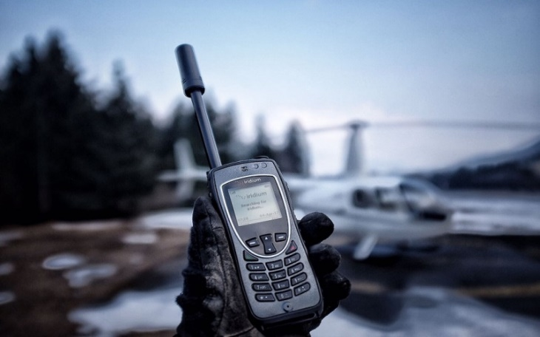
Satellite Communications
During natural disasters or from remote locations
Cell towers down or non-existent
Literally talking to space
Satellites in orbit pass overhead
Usually Iridium satellites
Voice and data from almost anywhere
Any handheld device could be security risk
Similar security issues to other smartphones
Only the service is different

Slide 5
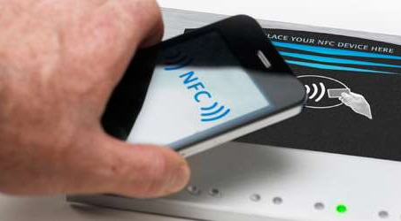
Near Field Communication (NFC)
Two-way wireless communication
Extension of one-way RFID
Payment systems use NFC
Google wallet
Apple Pay
Bootstrap for other wireless
NFC helps with Bluetooth pairing
Access token, identity “card”
Short range with encryption support
Your phone is the key (Some hotels offer NFC)

Slide 6
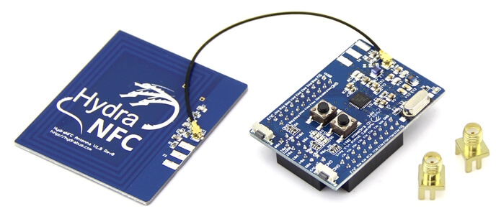
NFC security concerns
Remote capture
It is a wireless network
10m range for active devices
Jam known NFC frequencies
Denial of Service (NFC just won’t work)
Relay / Replay attack
Man in the Middle
Attacker “sniffs” NFC traffic and plays it back
Loss of NFC device control
Stolen/lost phone = Stolen/lose keycard

Slide 7

ANT/ANT+
Proprietary wireless sensor network protocol
2.4GHz ISM band (industrial, scientific, medical)
“Internet of Things” low-power protocol
Fitness devices
Heart rate monitors
Temperature sensors
Separate wireless service
Not 802.11 or Bluetooth
Denial of Service
Spectrum jamming
Encryption is optional
No method to maintain integrity
This is one of several competing IoT protocols. This topic likely to be removed on next Sec+ test update.

Slide 8
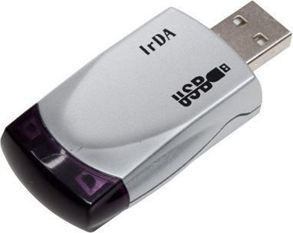

Infrared
Included on many mobile devices
Less popular these days
File transfers are possible
Any device within visual distance can “sniff” IR traffic
Other phones can be used to control your IR devices

Slide 9
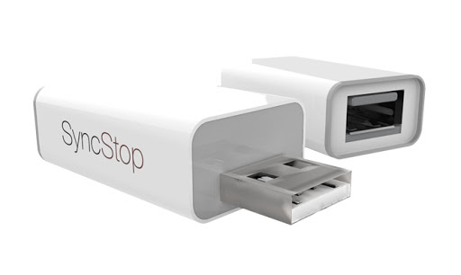
Universal Serial Bus (USB)
Physical connectivity to your mobile device
USB to your computer
USB, Lightning, or other proprietary connection
USB-C becoming de facto standard in EU
Physical access is always a concern
Is that USB port really just power?
A locked device is relatively secure
Enable auto-lock. If you walk away, it’s safe(r).
Mobile phones can also exfiltrate
Phone can appear to be USB mass storage device

